Slide 1
Interview Practice II
Carol Bartlett, MSc. (SHE/HER)
Jan 29, 2026
Notes:
Hi, everyone welcome to week two of the Lab2Market core program
Time is really flying by. It’s hard to believe we’re already into the second week
Hopefully you had a good week of getting out of the building, and engaging with potential customers and stakeholders
I imagine you are starting to gain some insights into your target customers and their problems
and validating your value proposition.
We have been talking a lot about customers and value propositions in the pre-program and core program to date, because it truly is the must fundamental building block of a successful business
But this week and for the remainder of the core program, we will start delving a little bit deeper into the other aspects of our business model
This week in particular, we will discuss customer relationships, and channels.

Slide 2
GOING DEEPER
JOBS TO BE DONE
AGENDA
TEST OUR SKILLS
IMPROVING OUR SKILLS: WRONG AND RIGHT QUESTIONS
4 KEY QUESTIONS
Notes:
Our agenda today deals with the following topics
[Read agenda topics]

Slide 3
Interviews:
Getting more information

Slide 4
Example:
If your research is on marine robotics for ocean monitoring, instead of asking:
❌ "Would you use a marine robot for data collection?"
Ask:
✅ "How do you currently collect oceanic data?"
✅ "What’s the most frustrating part of the process?"
✅ "Have you ever tried a different way? What happened?"
✅ "If you could magically fix one thing about your process, what would it be?"

Slide 5
Breakout session
Working in groups of 2 or 3, provide possible workarounds or solutions for this problem:
You are studying in small room. It has no windows. It has a desk and a chair. The light bulb in the overhead light fixture goes out.
List all the possible workarounds/solutions to solve this problem. Try to identify the cost (low, med, high) of the solution and the level of effort (low, med, high).

Slide 6

What is the problem
to be solved?

Slide 7
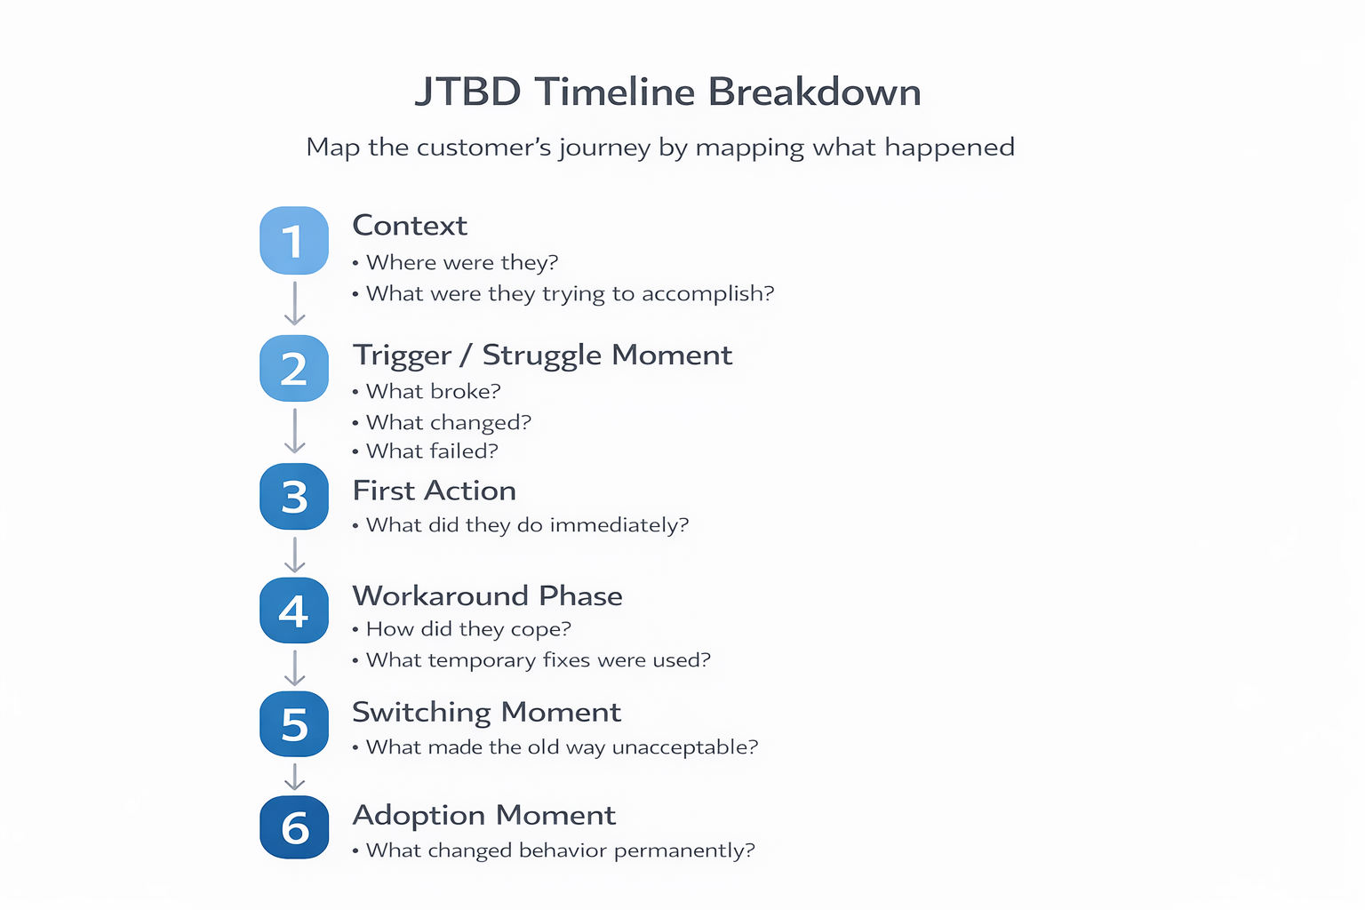

Slide 8
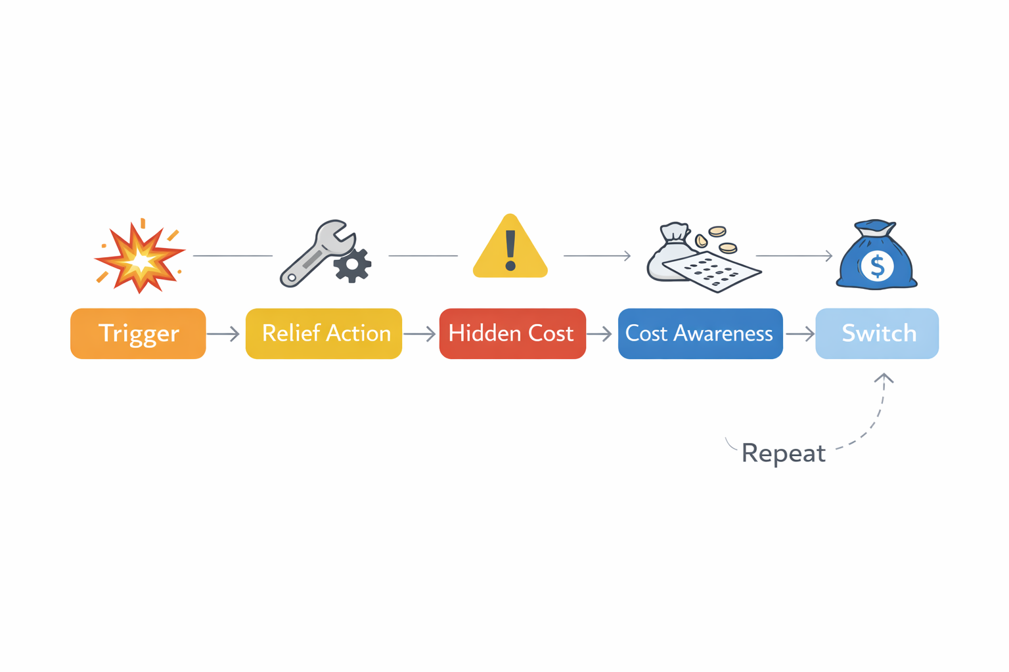

Slide 9
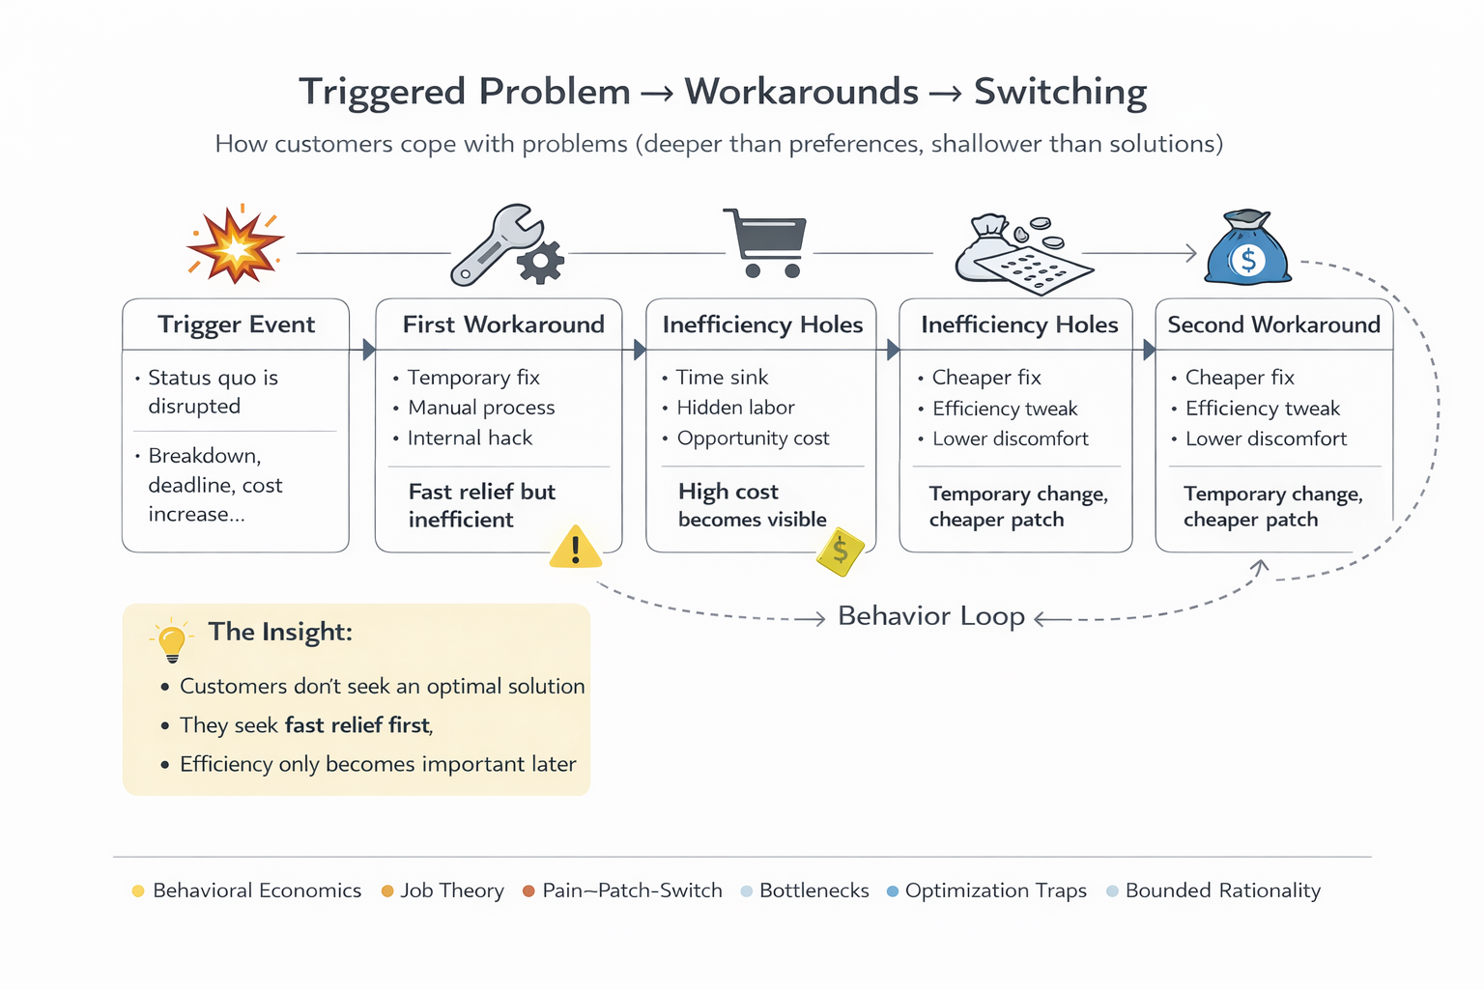

Slide 10
This Is Why Markets Look Irrational
Because customers are not optimizing for:
Best solution
Best product
Best architecture
Best long-term outcome
They are optimizing for:
Least disruption
Least risk
Least effort
Lowest visible cost
Fastest relief
Cognitive simplicity

Slide 11

Why This Matters for Sales, Strategy, and Innovation
Because:
Customers don't buy “better”
They buy less pain.
Customers don't seek transformation
They seek relief.
Customers don't seek efficiency
They seek comfort first, efficiency later.

Slide 12

What is Jobs to Be Done?
People Don’t Buy Products—They Hire Solutions
Customers "hire" products to solve a problem or achieve progress.
The real "job" isn’t the product—it’s the outcome they want.
Understanding this job helps build solutions that customers actually need.

Slide 13
Your job is to uncover what customers are really trying to accomplish.

Slide 14
How to Discover Jobs to be Done
🎯 Ask about past behavior, not future intent.
🚫 Avoid "Would you use this?"
✅ Ask:
“Tell me about the last time you had this problem.”
“What did you do instead?”
“How well did that work?”
“What almost stopped you from switching?”

Slide 15
If customers already found a way to solve the problem (even if inefficiently), it’s a strong signal of demand.

Slide 16


Slide 17
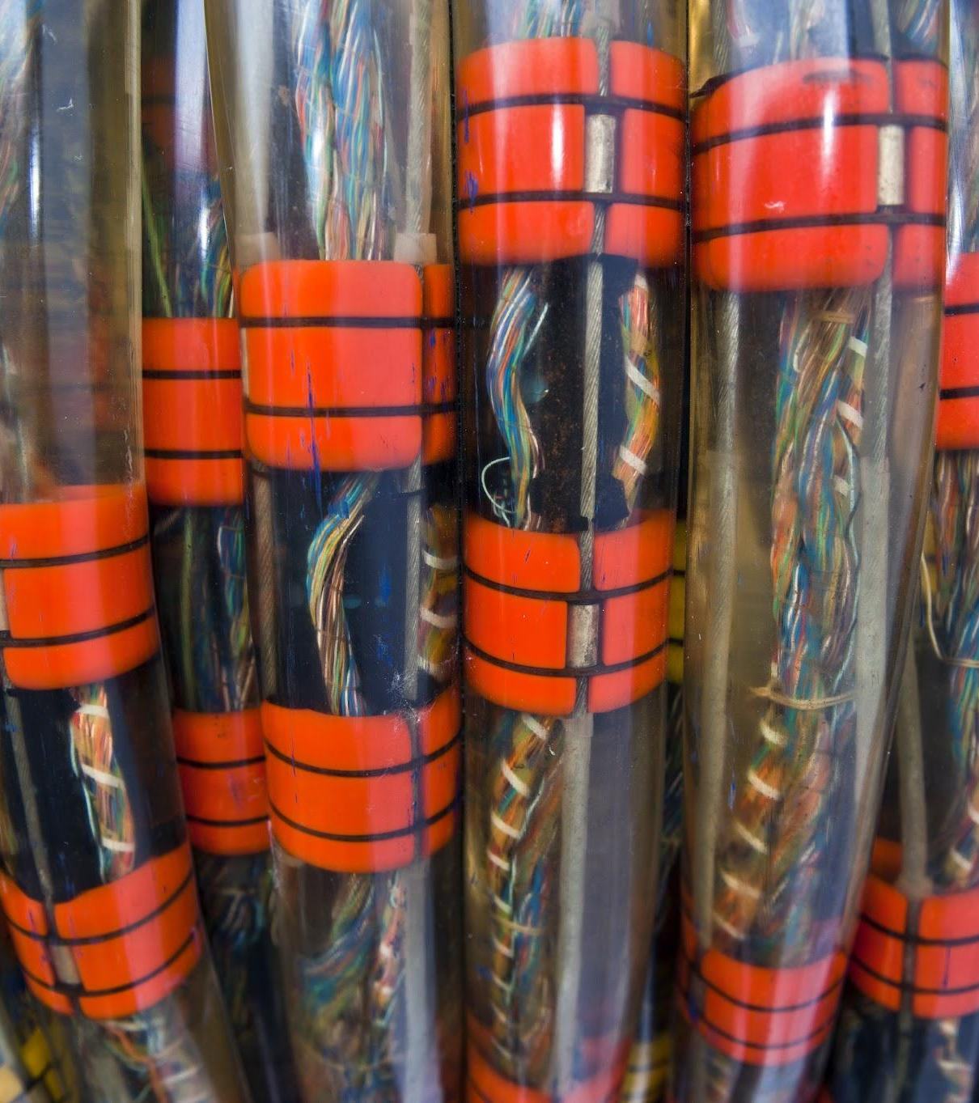
Let’s understand
1.the problem
2. the job to be done
3. the workaround
4. the cost of the problem

Slide 18


Slide 19

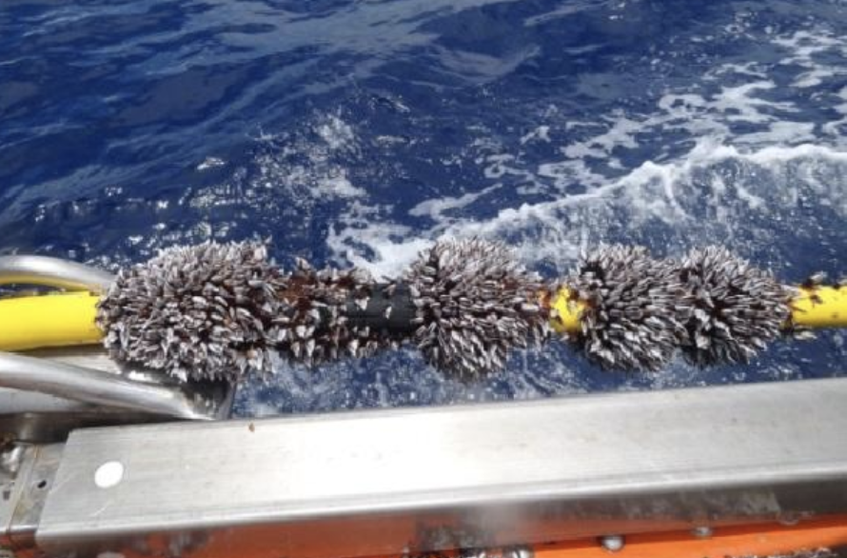

Slide 20
Tell me a story about the last time this happened?
How did you solve this problem?
What was frustrating about the way you handled it?
How much did this solution cost?

Slide 21
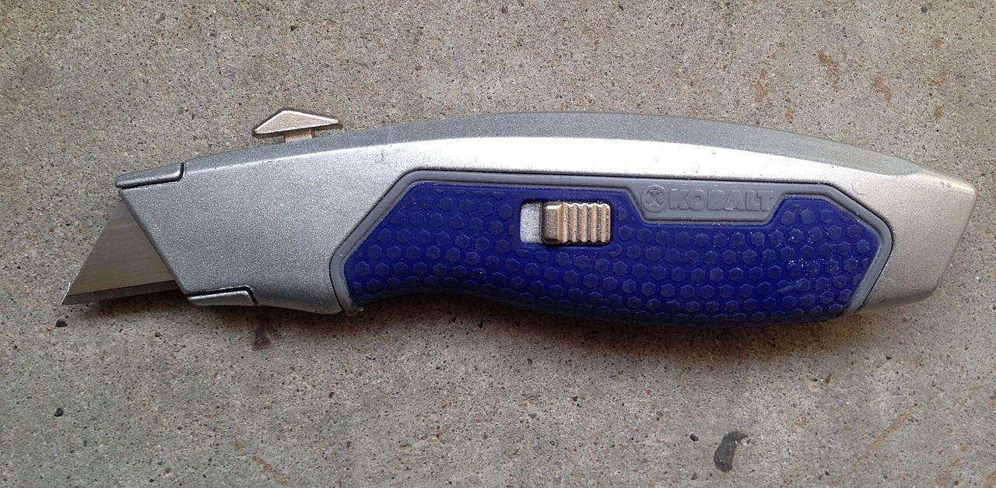
Customers don’t buy products; they hire solutions to get a job done.
The "job" is not always obvious—ask deeper questions to understand real pain points.
Successful companies solve jobs in a way that’s cheaper, faster, and easier than the current workaround.

Slide 22
The wrong vs right way to ask questions
❌ Bad Questions (Leading & Hypothetical) | ✅ Good Questions (Behavior-Based & Open-Ended)
“Would you use this product?” | “Tell me about the last time you faced this problem.”
“Do you think this is a good idea?” | “What solutions have you tried? What worked or didn’t work?”
“How much would you pay for this?” | “Have you ever paid for a solution to this problem? What was it?”
“Would you like this feature?” | “How do you currently solve this? What’s frustrating about it?”

Slide 23
Ask about past behavior, not opinions or predictions.

Slide 24
Digging Deeper: 4 Key Questions
1. Start with a Story:
“Tell me about the last time this happened.”
Why? This avoids hypothetical answers and gets real-world examples.
2. Identify the Workaround:
“How did you solve this problem?”
Why? If people are already solving it (even inefficiently), there’s demand.
3. Find the Pain Points:
“What was frustrating about the way you handled it?”
Why? This reveals what customers actually care about improving.
4. Uncover Willingness to Pay:
“Have you ever paid for a solution to this problem? Why or why not?”
or How much did it cost?
Why? If people have paid before, they’re likely to pay again.

Slide 25
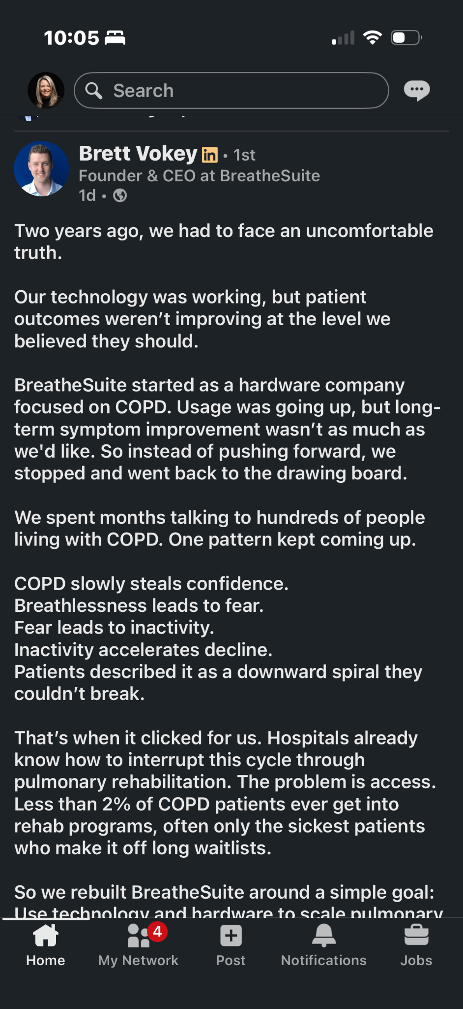
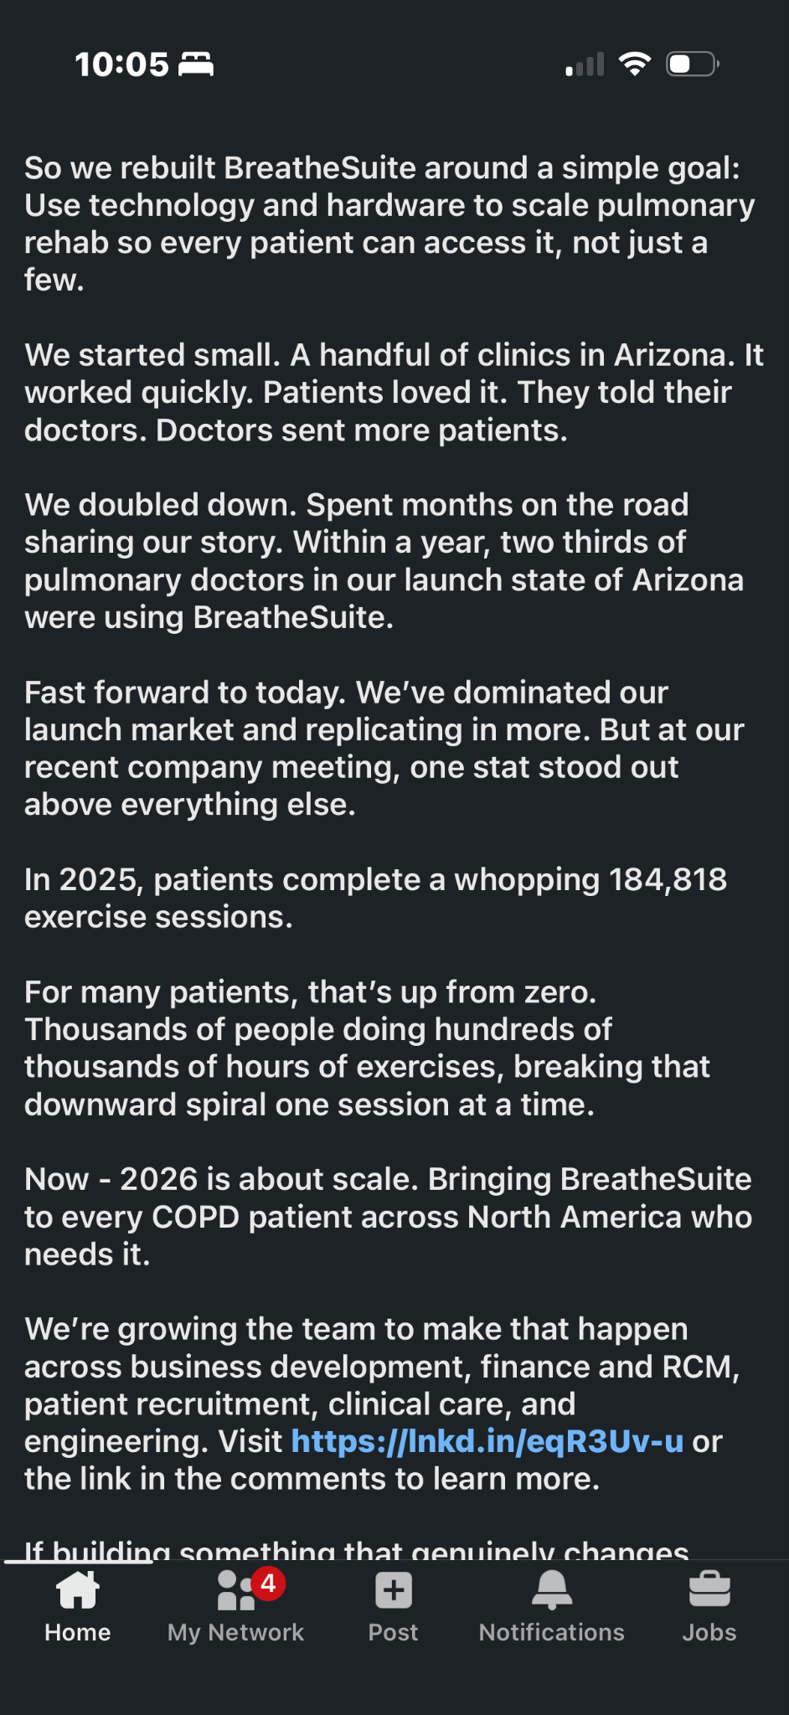

Slide 26
People’s actions (not their words) tell you what they truly value.

Slide 27

Groups
Why did you decide to study at your university?
Switch roles
Why did you decide to join this club or L2M?

